Slide 1
Dowry Cases Analytics
By Mayank Bhatt

Slide 2
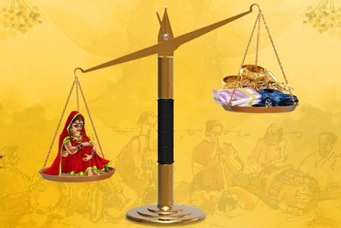
Firstly, what is Dowery ?
A dowry is a payment, such as money, property, or cattle, that a bride's family gives to the groom or his family at the time of marriage. In some cultures, a dowry is a woman's property that she brings to her husband in marriage.

Slide 3
Dowry-Related Crimes in this project
Dowry Prohibition Act
Dowry death
The Dowry Prohibition Act, 1961 is a social legislation that aims to prohibit the giving or taking of dowry and to protect married women from cruelty and violence. The Act came into force on July 1, 1961, except in the state of Jammu and Kashmir.
A woman's death is considered a dowry death if it occurs within seven years of marriage and is caused by burns, bodily injury, or other unnatural circumstances. It must also be shown that the woman was subjected to cruelty or harassment by her husband or relatives in connection with a dowry demand.

Slide 4

So, first thing was to clean the data
I utilized techniques and workflows from a previous project I worked on, focused on data cleaning and preprocessing. My old project (GitHub Repo) involved handling messy datasets, removing inconsistencies, and preparing the data for analysis. In my new project, I applied these same principles to streamline and improve the data pipeline, making the cleaning process more efficient and scalable.

Slide 5
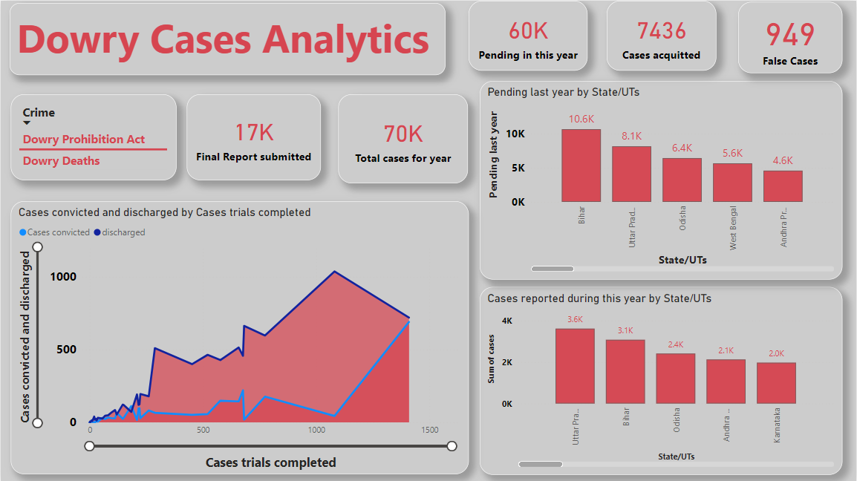
Then made a dashboard out of Clean Data

Slide 6
📊 Dowry Cases Analytics Dashboard 📊
This dashboard provides a comprehensive overview of dowry-related cases, focusing on data under the Dowry Prohibition Act and Dowry Deaths across different Indian states and UTs. Here's a breakdown of the insights shown:
📌 Key Metrics
Pending Cases (60K) – Cases still pending in this year.
Cases Acquitted (7436) – Number of cases where the accused were acquitted.
False Cases (949) – Cases found to be false due to mistakes of fact or law.
Final Report Submitted (17K) – Number of cases where final reports were submitted.
Total Cases for the Year (70K) – Total number of dowry-related cases recorded this year.

Slide 7
📈 Charts and Insights
Cases Convicted and Discharged
A line and area chart showing the number of dowry cases convicted (blue) and discharged (red) based on completed trials.
The chart illustrates a significant spike in discharged cases compared to convictions, highlighting challenges in securing convictions.
Pending Cases by State/UT
A bar chart showing pending cases from the last year by state.
Bihar leads with 10.6K pending cases, followed by Uttar Pradesh (8.1K), Odisha (6.4K), West Bengal (5.6K), and Andhra Pradesh (4.6K).
Cases Reported This Year by State/UT
Another bar chart displaying new cases reported during the year.
Uttar Pradesh tops with 3.6K cases, followed by Bihar (3.1K), Odisha (2.4K), Andhra Pradesh (2.1K), and Karnataka (2.0K).

Slide 8
🧐 Observations
The high volume of pending cases and the disparity between convictions and discharged cases indicate a need for faster resolution and more effective law enforcement.
States like Uttar Pradesh and Bihar continue to see significant numbers of reported and pending dowry cases, highlighting critical regions for intervention.
This dashboard uses data visualization to offer a clear and actionable understanding of dowry-related cases in India. Such insights can help policymakers and law enforcement agencies prioritize efforts to tackle dowry-related crimes effectively.

Slide 9
THANK YOU
Data.gov.in – Government Open Data Portal (2013)
This is India’s official open data portal, offering datasets from various government departments.
Website: https://data.gov.in
Keywords to Search:
"Dowry cases

